Slide 1
The interface between EU competition law and standard essential patents –the Huawei case with some reflection on the US development
Björn Lundqvist
Björn Lundqvist (2015) The interface between EU competition law and standard essential patents – from Orange-Book-Standard to the Huawei case, European
Competition Journal, 11:2-3, 367-401, DOI: 10.1080/17441056.2015.1123455
Notes:
Grateful… that i ahve been invited and that you all showed up, and I hope.
Paper is a article or perhaps a chapter in a book that rather discuss standard-setting from art 101 perspective…. Then art 102… I will perhaps talk a bit about art. 101 too.

Slide 2
What is the issue?
The Patent War.
When may holders of standard essential patents (SEPs), who made FRAND commitments, be abusing its dominant position? When, for example:
Making use of injunctions, and/or
Not giving access to SEPs on FRAND terms,
Demand to obtain cross-licenses/grant backs of non-SEPs, non-challenge covenant,
Selling SEPs to PAEs,
Over declaring patents as essential, or
Discriminate in case of giving access to SEPs, thus
Whether and when holders of SEPs are obliged under competition rules to grant access to SEPs on FRAND terms?
Notes:
When may holders of standard essential patents (SEPs) be in breach on Art. 102?
More of an inpeth analysis of whether holders of SEPs are obliged under comeptition law t give acess on FRAND terms.
This presentation deals with access to standards and essential standards under art 102. To set the Art 102 cases in perspective I eill also discuss the US development and to some extent teh German development. That is not to say that the issues I am discussing may be judged also under art 101 (and also under the exemption under patent law).
I will touch upon the us development and also to some extent the german development of case law.
In the end I claim that perhaps we should get somewhat insproied by teh development in the us of using IP law doctrines in tehse cases rather then competition law.

Slide 3
Background
Industry standards are needed for IT interoperability, telecom and other forms of networks. It creates compatibility and interoperability among products and services, which is increasingly essential to many industries.
Generally leads to economic efficiency and significant consumer benefits, but
Interoperability standards are both plagued by “network effects” and the infrastructure of today’s society
Proliferation of IPR:s in certain important industries
“Defensive Patenting” and “Strategic Patenting”
“Patent Thicket”
“Anti-commons”
Mutual Assured Destruction” (MAD)
Patent Wars
Proliferation of SSOs, consortia and fora
Notes:
Why patent war???

Slide 4
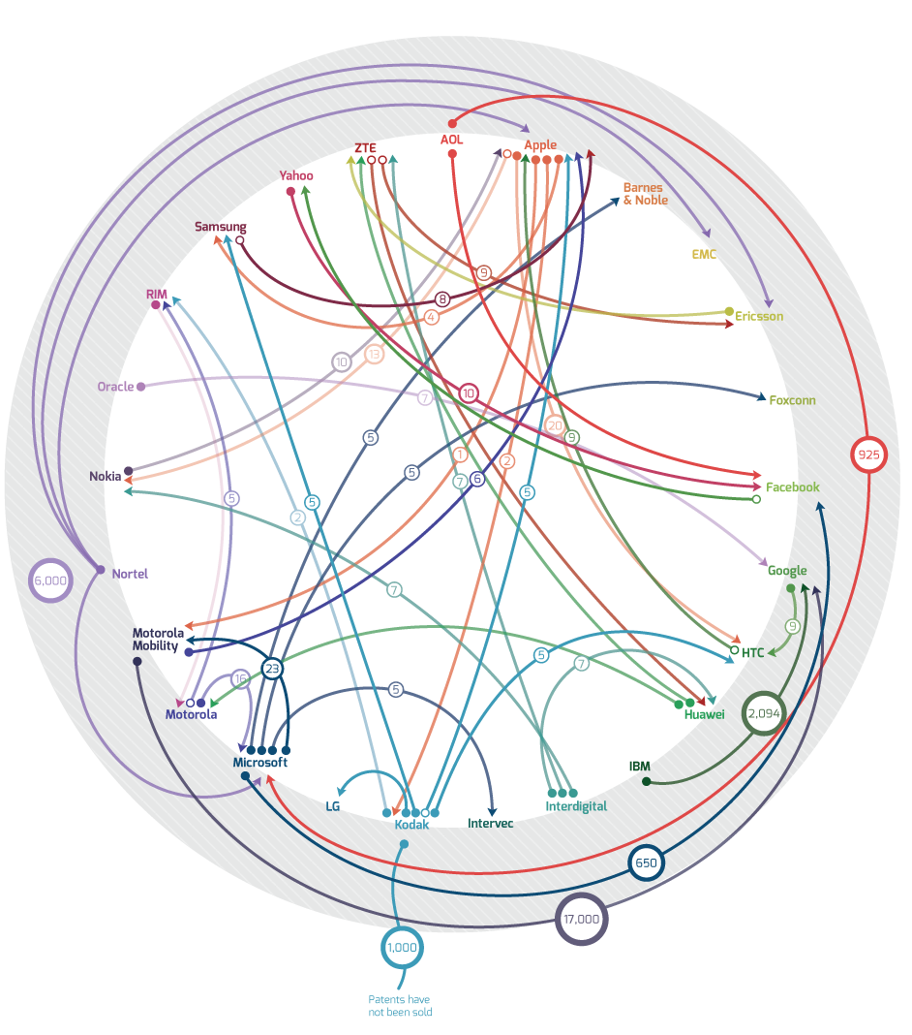
Standards cases
EU Cases and investigations
IGR/Salora (1981; 1984)
X/Open Group (1987)
ETSI IPR Undertaking (1994)
Rambus (2009)
Qualcomm (2009)
IPCom (2009)
EMC (2010)
Standard & Poor’s (2011)
Fr.bo (2012)
Google/Motorola (2012)
Honeywell (opened 2012)
Samsung and Motorola (opened 2012)
Servier (opened 2012)
German cases, e.g.
Standard Tight-Head Drum (2005)
Orange-Book-Standard (2009)
Dutch cases
Huawei v. Ztd (2015)
US Cases and investigations
In re Dell (FTC, 1996)
Allied Tube (1988) plus other cases
Unocal (FTC, 2004)
Qualcomm v. Broadcom (various)
Rambus (FTC 2006, D.C. Cir. 2007)
US Philips I and II (Fed.Cir. 2005; 2010)
Various ITC cases
eBay (S.Ct. 2006)
Apple v. Samsung (Northern California 2012)
Apple v. Motorola (Northern Illinois 2012)
Microsoft v. Motorola (W.D. Wash. 2012)
FTC Google consent order (2013)
Notes:
Every day brings a new lawsuits or development between Aplle, HTC, Microsoft, Motorola Mobility (MMI), Nokia and Samsung. Numerous courts and several continents. Apple and Microsoft and Google Android operating system HTC, MMI and Samsung on the other.
SEP (standard essential patents)
Wireless broadband, compression technologies (H.264), or telecommunications stanadrs (4G LTE)
Actually the fusion or merger of two different patent thickets, i.e . The thicket for telecommunicatona and the IT interoperability thicket.
Google consent order stipualte a procedure under art 5 FTC act for frand--- no blaCK CLAUSES…
Both parties that do not license and the other way around.

Slide 5
The US doctrine
Under IP law, Ebay-rule
No injunction, public policy considerations
Rewarded damages, i.e. compulsory licensing scheme
However, patent misuse, estoppel, waiver doctrines imply that deceiving a SSO may render the SEPs in fact unenforceable (Federal Circuit, Qualcomm)
Under Art. 5 FTC Act, unfair competition
Google, Re. Bosch etc. Art 5 FCT Act, but beyond Antitrust law.
No black clauses
Under Antitrust law
Sherman Act sec. 2 may be applicable (attempt to monopolize) when an patentee deceive an SSO
According to Rambus, need to show anticompetitive effect
Antitrust law more patentee friendly than IP law?

Slide 6
European development
Patent ambush/excessive pricing
Rambus (2009)
Qualcomm (2009)
IPCom (2009)
Dominance
Google/Motorola (2012)
Injunctions and interpretation of FRAND
Samsung and Motorola (2014)
Huawei v. Ztd (CJEU 2013)
German cases
Standard Tight-Head Drum (2005)
Orange-Book-Standard (2009)
Motorola, Microsoft, Apple, Nokia, Ericsson, IPCom in several courts
UK cases
Nokia v. IPCom
Motorola, Microsoft, Apple,

Slide 7
Huawei-case
Only in exceptional circumstances may the constitutional character of intellectual property rights be restricted, and the ECJ agrees that in the dispute before the Court, a new exceptional circumstance scenario is at hand:
first, by the fact that the patent at issue is essential to a standard established by a standardisation body, rendering its use indispensable to all competitors which envisage manufacturing products that comply with the standard to which it is linked
Secondly, the case should be distinguished by the fact that the patent at issue obtained SEP status only in return for the proprietor’s irrevocable undertaking, given to the standardisation body in question, that it is prepared to grant licences on FRAND terms.

Slide 8
Huawei-case continue
ECJ stipulates the good governance procedural rules, which the parties in these situations must adhere to so not, on the one hand, to abuse a dominant position, nor, on the other, cause the national court to agree to order an injunction and removal of goods. In this part of the judgment the ECJ follows the few procedural rules stipulated by the AG, which in turn, to a large extent, mirror the outline in the Samsung decision by the Commission and the FTC Google settlement.
The proprietor should offer a license on FRAND terms.
The willing licensee should diligently reply and accept or otherwise produce a counter-offer.
However, the ECJ is also somewhat more conservative.

Slide 9
Comparativa analysis
The USA the IP law connected doctrine under the rules of injunction seems to imply that equity and public policy considerations above and beyond the ambit of US Antitrust law
is the US development also above and beyond An euro (competition law) defence? In other words, easier access to SEPs in the US?
In Europe it seems that EU Competition law is more readily available than the exemptions under Member States’ patent laws. Public policy requirement not fulfilled?
An indication how fast the US jurisprudence may shift
Notes:
Would the exemptions under the Member States’ patent laws, i.e. the compulsary licensing rules, be a solution to the FRAND ambush scenario?

Slide 10
Thank you,
Dr. Björn Lundqvist,
bl.jur@cbs.dk

Slide 11
The source of the problem, IP law. Are we seeing an embryo to a solution?
New patent rules in the USA, and a new EU patent system
Post-grant opposition in the US
Third parties may submit prior art
Supreme court cases
eBay (2006)
KSR v. Teleflex (2007) the obviousness
Quanta v. LG Electronics (2008), exhaustion or first sale principle
MedImmune (2007), standing
Combined effort US and EU PTO regarding lessening certain malfunctions.
E.g. trying to limit the possibility for divisionals of patent applications, the amount of pending patents and the number of claims
More collaborations between PTO and competition authorities?
More collaboration between PTO and SSOs?
Notes:
KSR prevents patent flooding. Or could that be an abuse… in itself…

